Slide 1
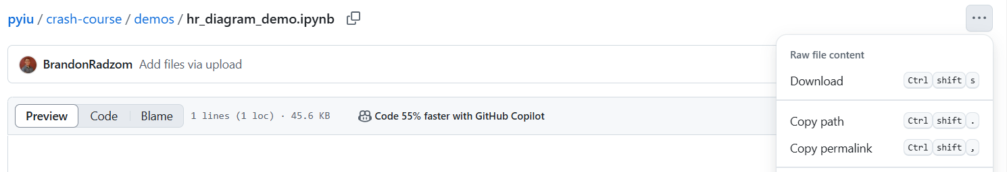
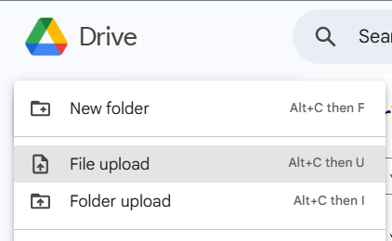

Pre-Workshop Instructions
Navigate to github.com/BrandonRadzom/pyiu
Click on “crash-course”, then “demos”
Click on “hr_diagram_demo.ipynb”, press the three dots in the top right corner and click “Download”
Upload this file to your Google Drive, and double-click it. This will open Colab!
You’re now ready to code with us!

Slide 2


PyIU: Python for STEM Crash Course
03/05/25
NASA, ESA, CSA, and J. Lee (NOIRLab), A. Pagan (STScI)
AN INTRODUCTION TO PYTHON FOR UNDERGRADUATES INTERESTED IN ASTRONOMY/SCIENTIFIC RESEARCH
By: IU Astronomy & Physics Graduate Students
(Amelia Binau, Jordan Bruce, Kristin Baker, Lexi Gault, Samantha Goldberg, Robert Howard, Jack Lyons, Daniel Ornelas, Sarah Popp, Brandon Radzom, Jessica Ranshaw)

Slide 3
Crash Course Purpose
Most astronomers, physicists, and other scientists use programming as a tool to understand/analyze data for research
Yet, most DO NOT receive any formal education on programming
This results in:
Barriers to enter research
Hard-to-read code
Non-reproducible science
Poorly optimized/slow code
Inefficient code dev. -> inefficient research

Slide 4
By the end of this Crash Course, you will…
Understand the core strengths of Python
Get a brief, introductory overview of Python basics
Produce code on your own jupyter notebook on Google Colab
Understand the basics of:
Writing readable code
Print statements, variables, & lists
Logic & loops
Functions
Plotting
All while learning about the H-R Diagram!

Slide 5

with Python!

Slide 6
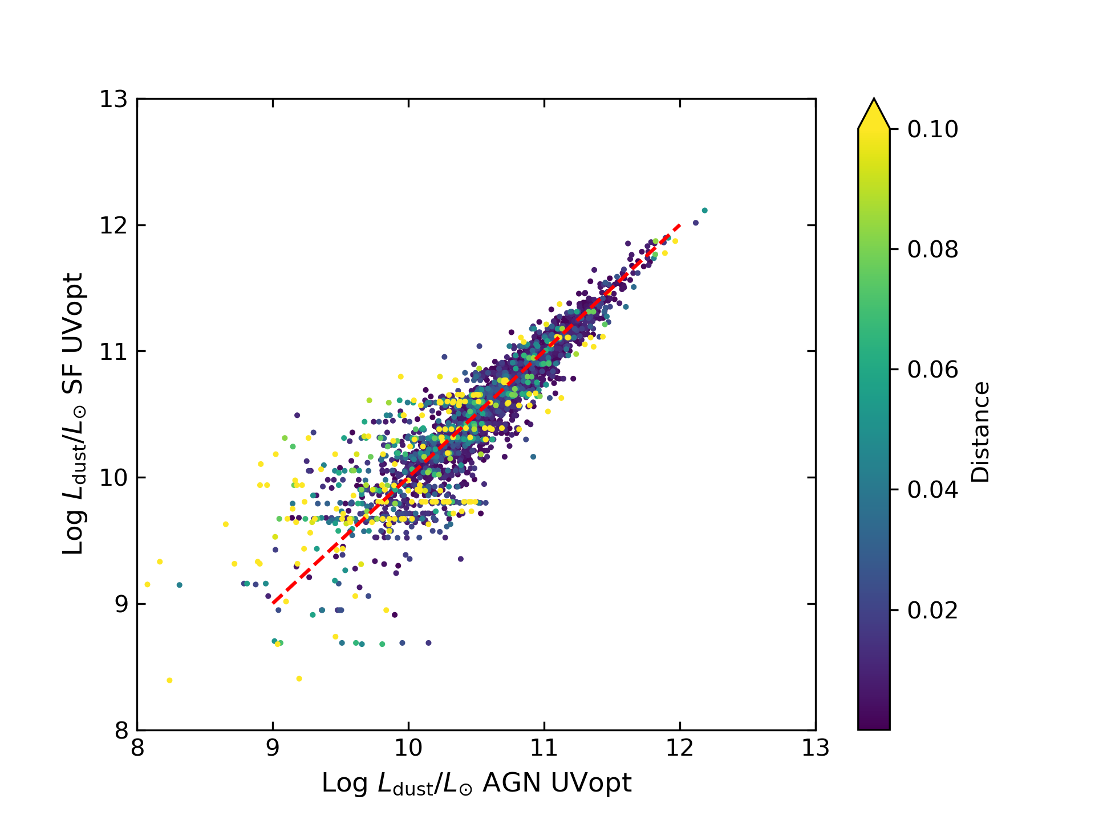
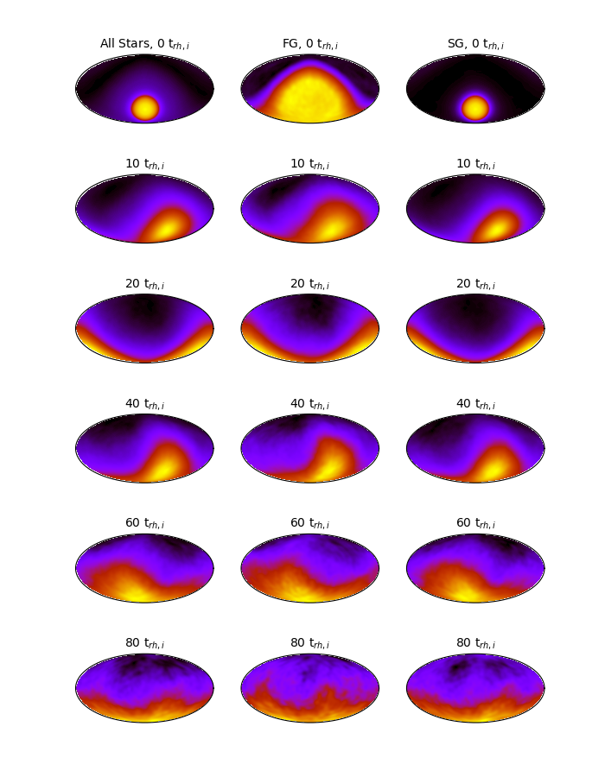
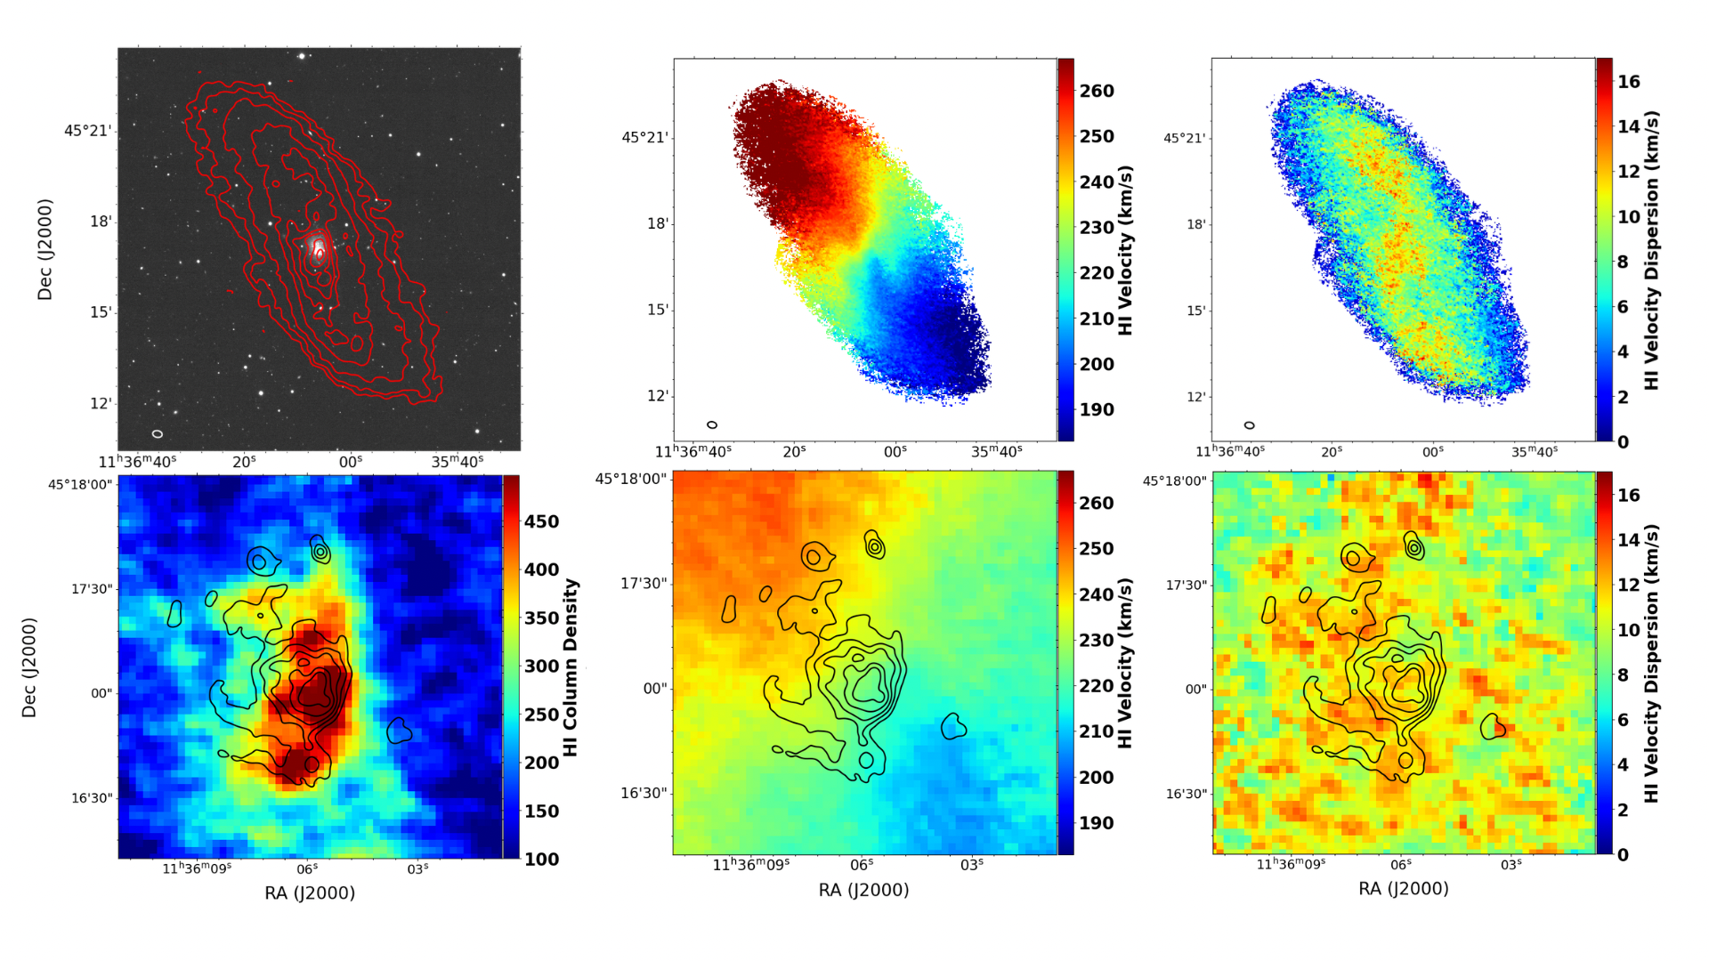
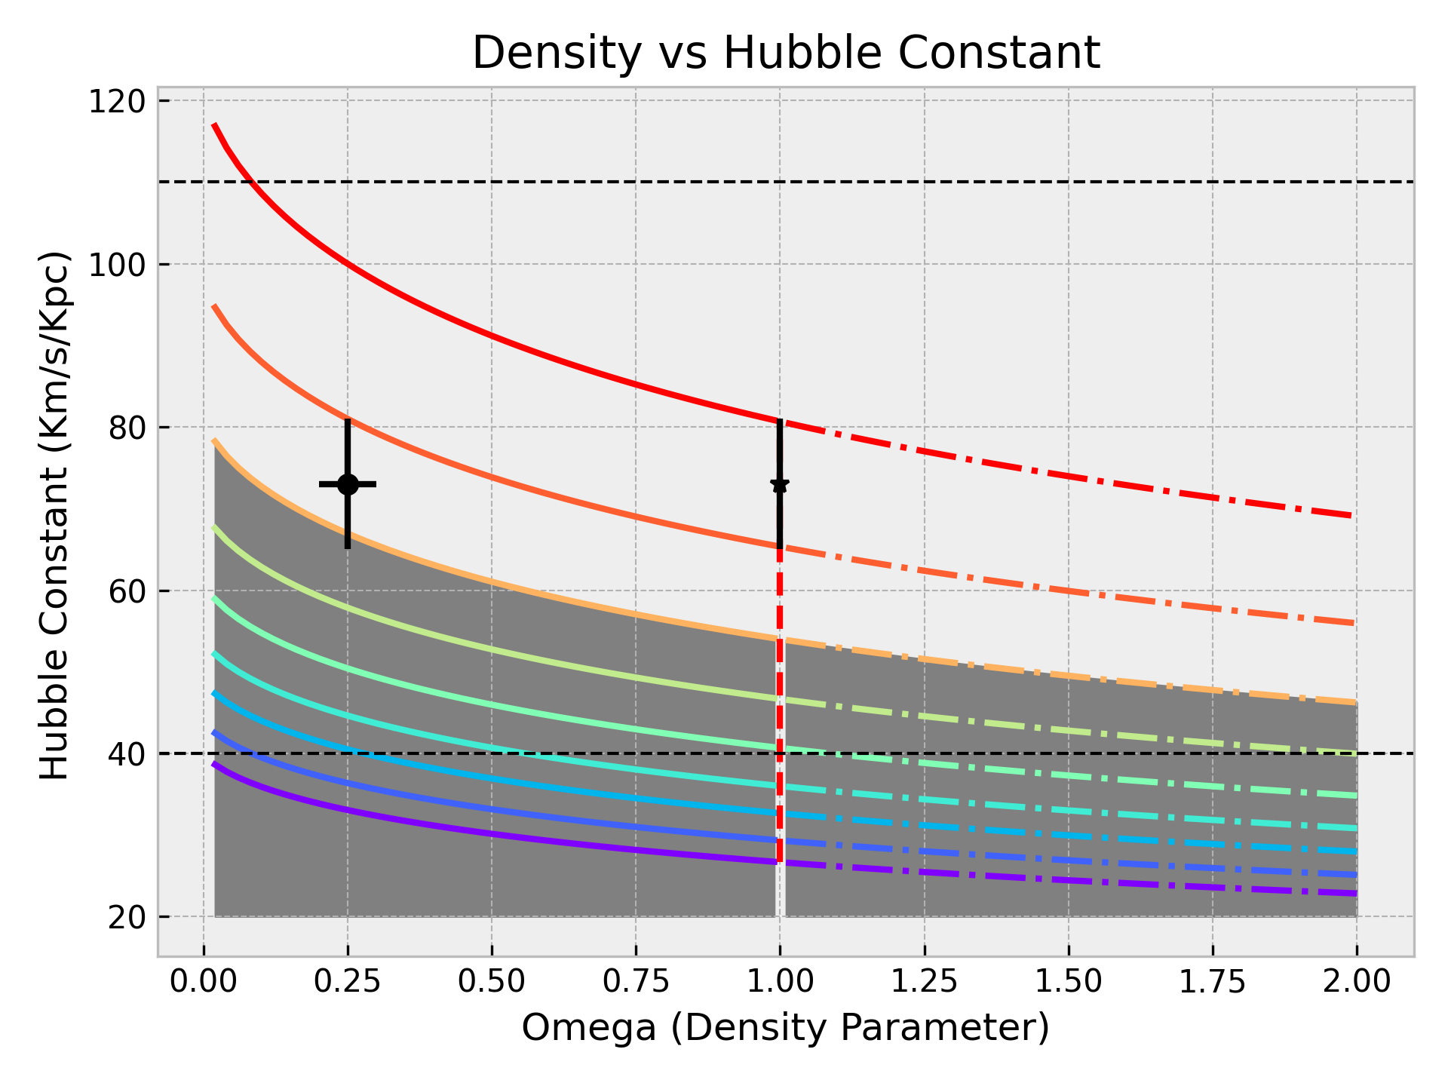
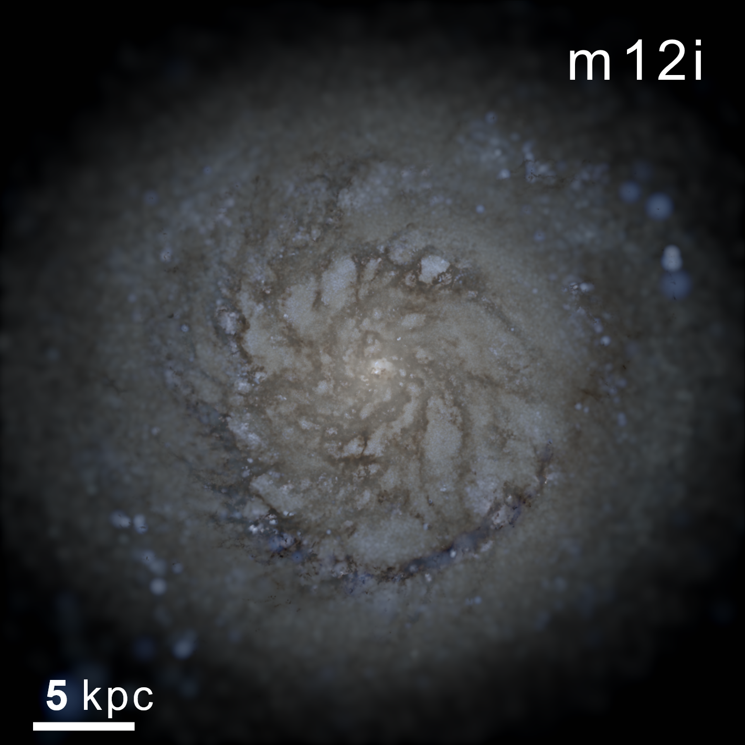
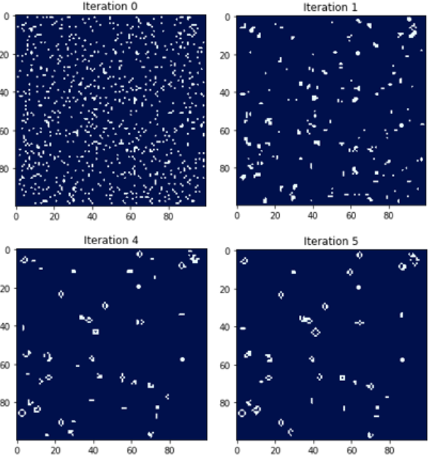
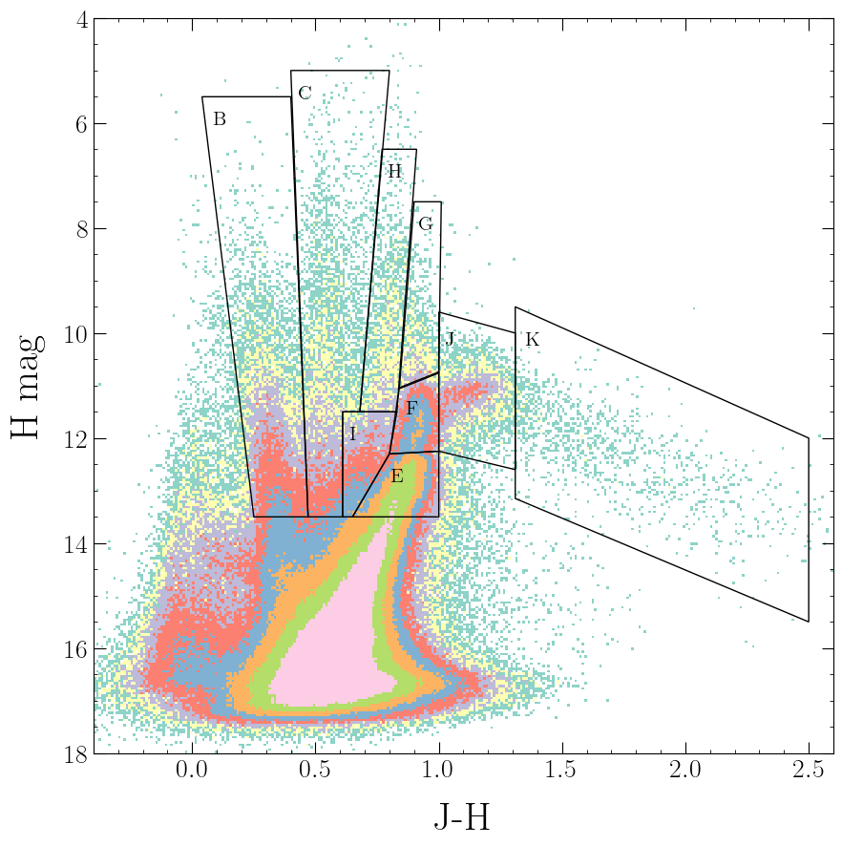
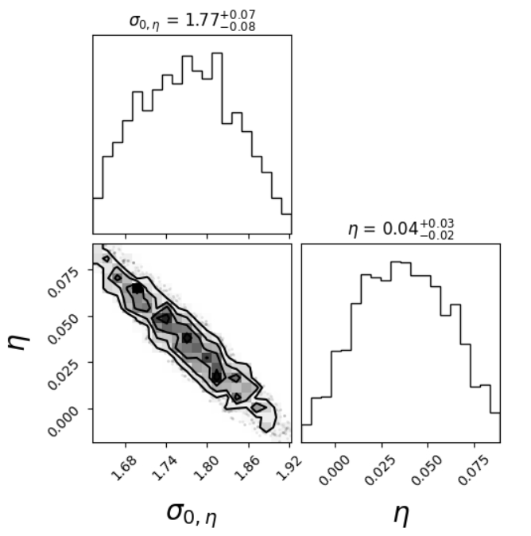
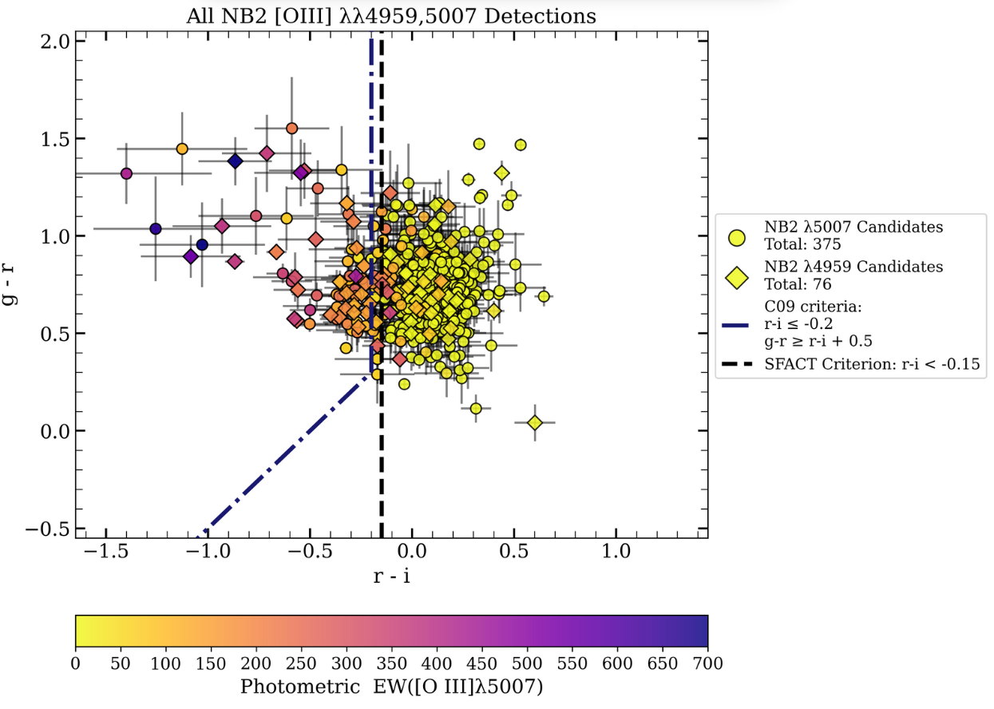
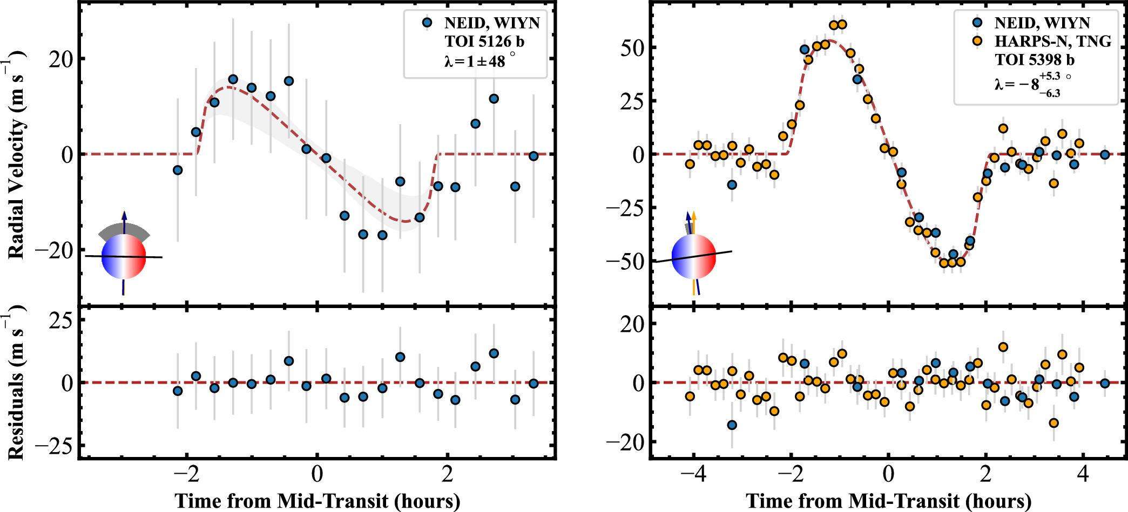
What we’ve done with Python!

Slide 7

Python
Documentation: https://docs.python.org/3/
Other common languages:
C++
Javascript
SQL
R
MATLAB
Rust
Perl
HTML & CSS
Fortran
Pros of Python:
Simple and user-friendly
Interpreted, high-level language
Cons:
A bit of a black box, slow
Interpreted, high-level language
Easily readable to humans… not so much for a computer
Lots of “layers” to executing the code, computes line-by-line

Slide 8


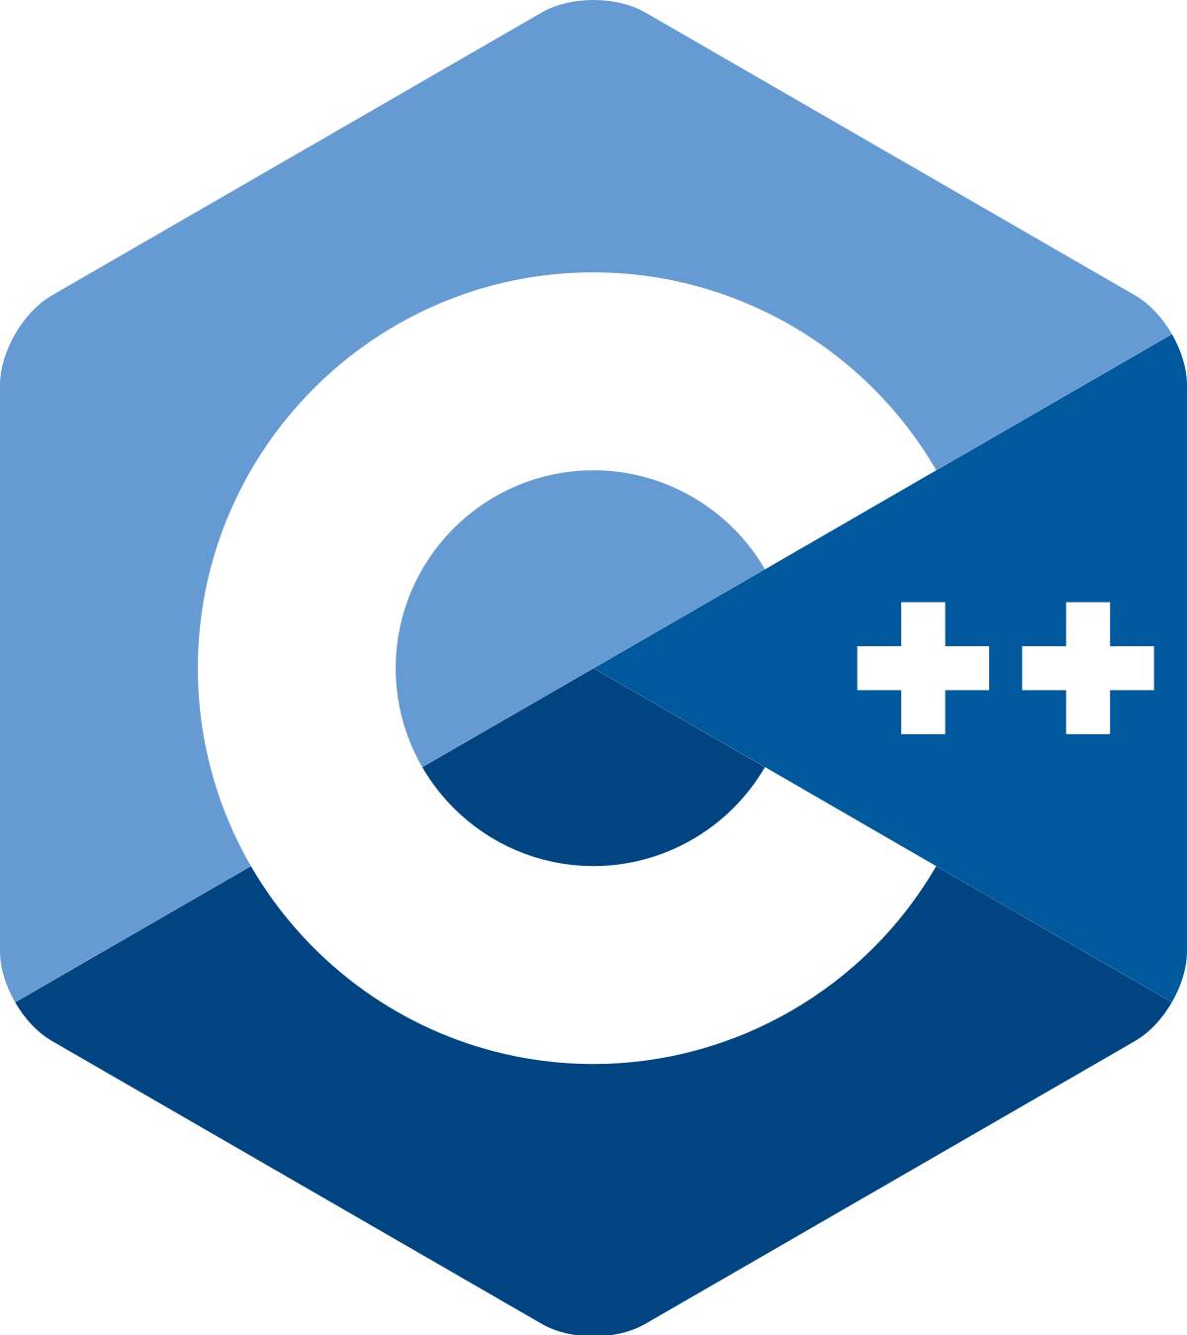


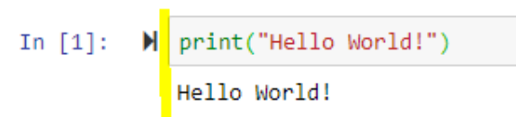
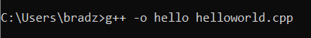
A Demonstrative Example: “Hello World”
C, C++,
Fortran, IDL
Python
#include <iostream>
int main() {
std::cout << "Hello World!";
return 0;
}

Slide 9








Where to write code in Python

Slide 10

Where to write code in Python

Slide 11
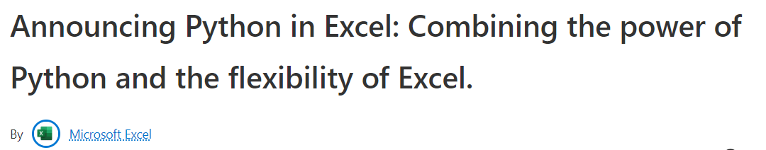
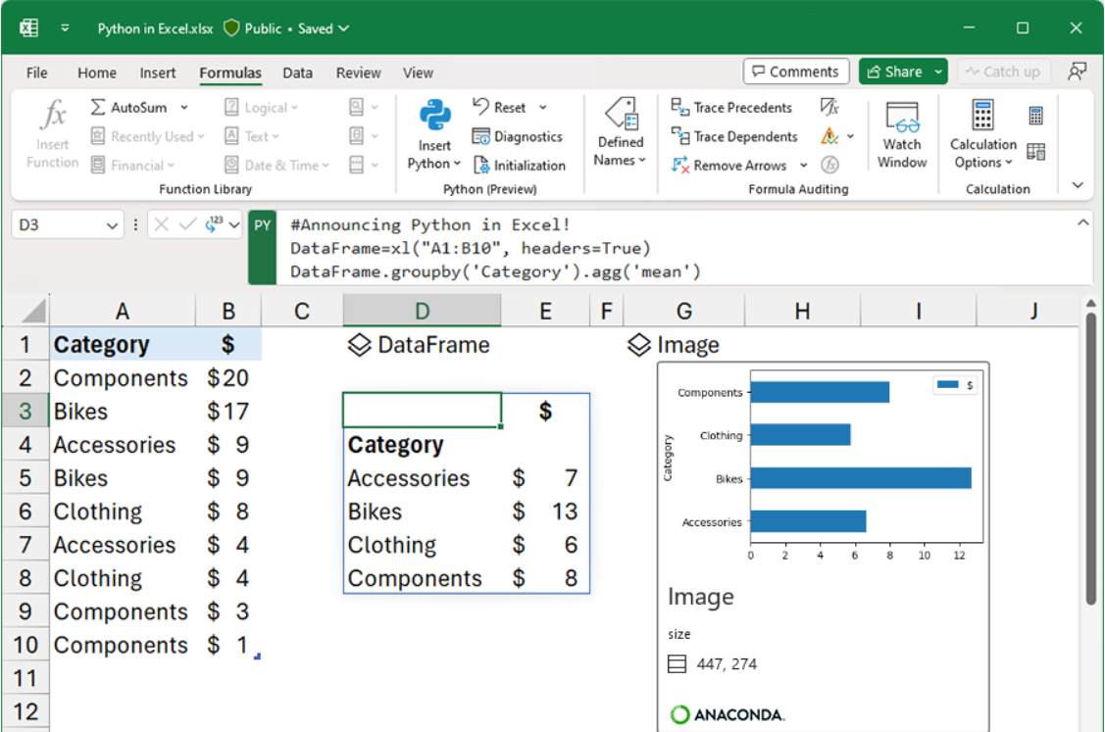
Where to write code in Python

Slide 12




Where to write code in Python
IDEs: Integrated Development Environments
PyCharm
VSCode

Slide 13
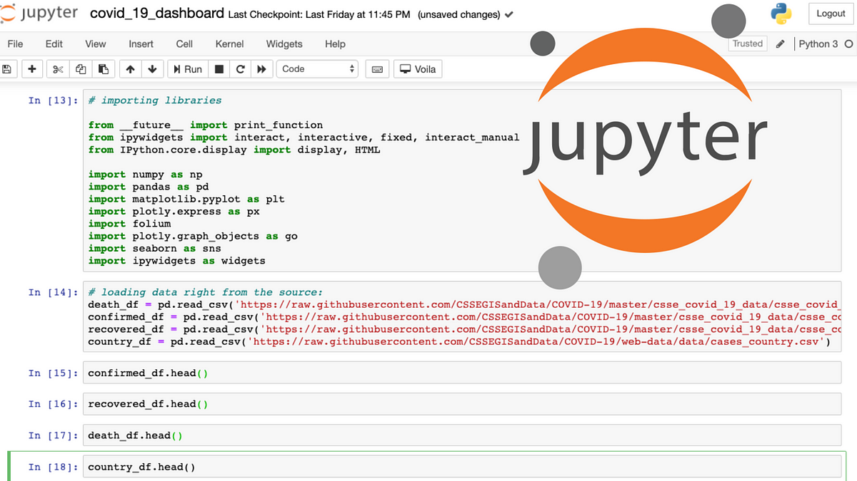
What we’re using for the Crash Course
Jupyter notebook: web-based interactive Python development tool
Cell-by-cell code blocks allow for:
Easy debugging & visualization
Quick and efficient code development

Slide 14
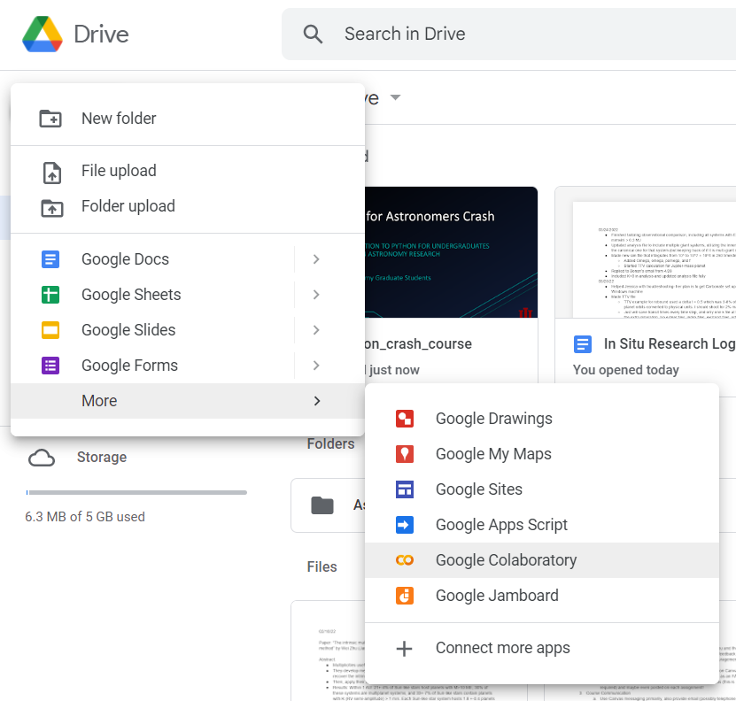

How we’re accessing Jupyter:
Google “Colab”oratory
colab.research.google.com/
Free web-based access to Jupyter notebooks
Contains searchable practice examples and datasets
Allows collaboration (Google docs but for coding)

Slide 15

Pre-Workshop Instructions
Navigate to github.com/BrandonRadzom/pyiu
Click on “crash-course”, then “demos”
Click on “hr_diagram_demo.ipynb”, press the three dots in the top right corner and click “Download”
Upload this file to your Google Drive, and double-click it. This will open Colab!
You’re now ready to code with us!

Slide 16

Let’s Code!

Slide 17

Advanced Python Workshop: Coming April 2025!
Learn techniques that you can apply directly to your research/upper-level coursework
Casual, highly-interactive environment with experienced instructors
Potential topics:
Python installation/environments
Reading & writing files
Advanced plotting
Statistics
Numerical integration & simulations
Big data analysis & data fitting
YOU tell US!
Python .
Python .

Slide 18
BONUS SLIDES

Slide 19

Other Free Web-based Resources
Kaggle: https://www.kaggle.com/
Access Jupyter notebook
Python courses, lots of data science material
Practice datasets, online access to Jupyter, etc.

Slide 20

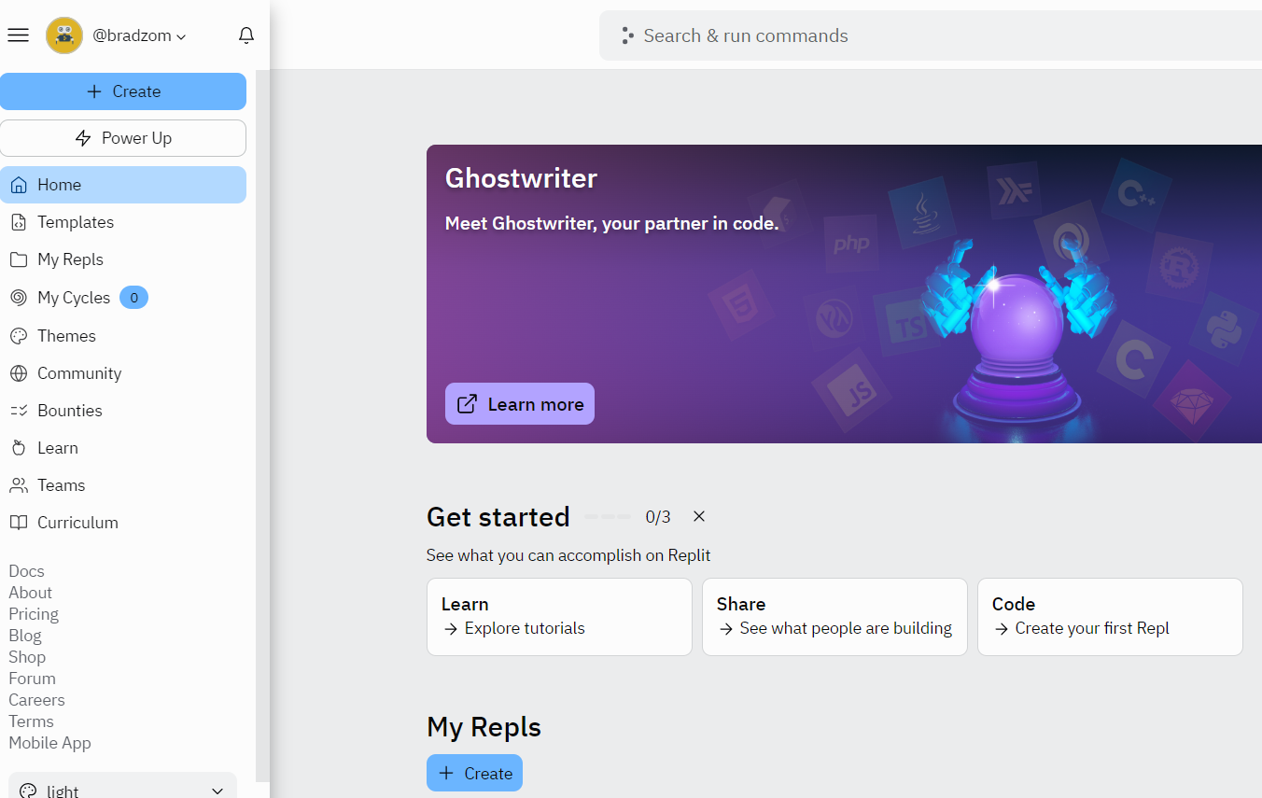
Other Free Web-based Resources
Replit: https://replit.com/
Must make account
Create scripts in Python, C++, Java, HTML, etc.
Collaborate with others using any language

Slide 21

Python & Anaconda/miniconda
Anaconda is a distribution platform for Python
The Conda environment handles issues & dependencies for you
Anaconda Navigator: graphical user interface for Conda
miniconda: lightweight version of anaconda, good if you have multiple environments

Slide 22
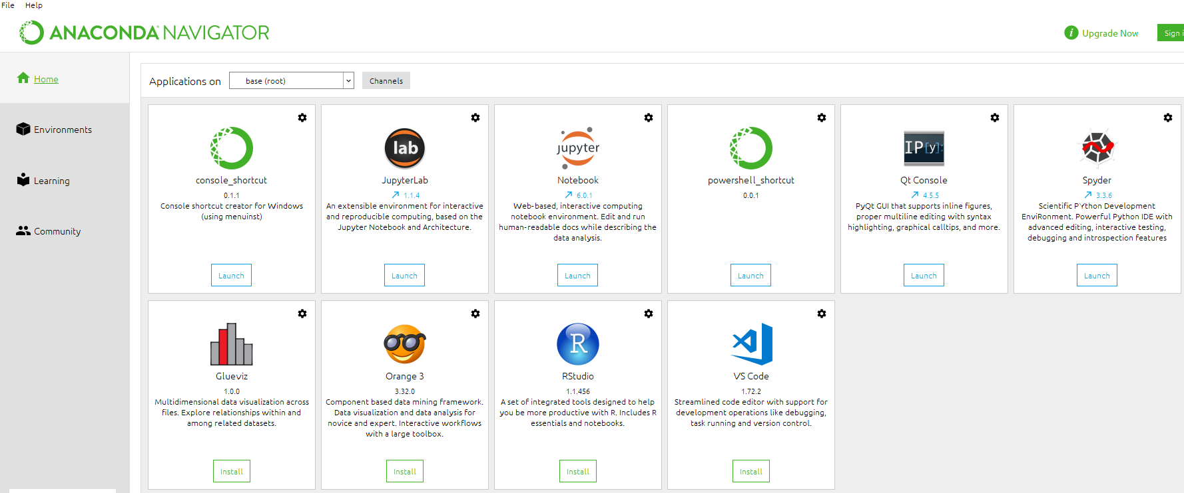
Anaconda Installation (personal computer)
Go to: https://www.anaconda.com/products/distribution
View from “Navigator” should look like:

Slide 23
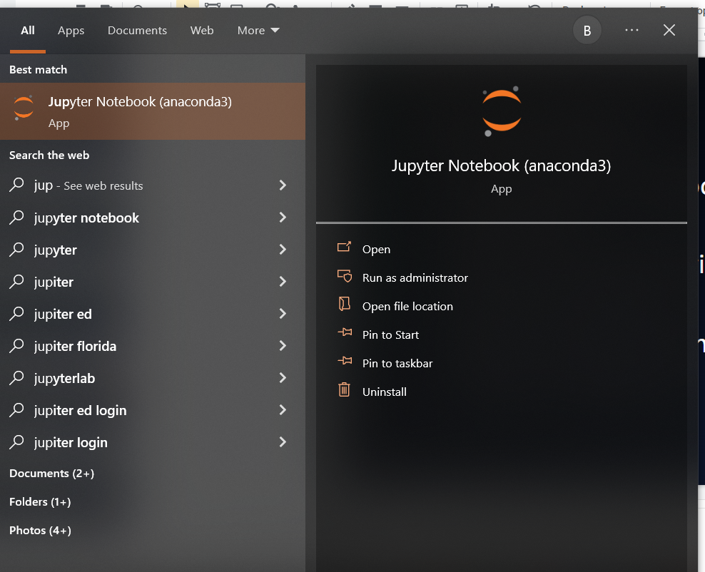
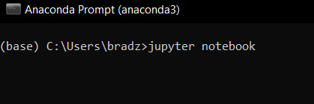
Running Jupyter
Personal computer:
Open the “Anaconda Navigator” -> click “Launch” under Jupyter logo
Type “Jupyter notebook” in your local search bar
Open the “Anaconda Prompt” -> enter “jupyter notebook”

Slide 24
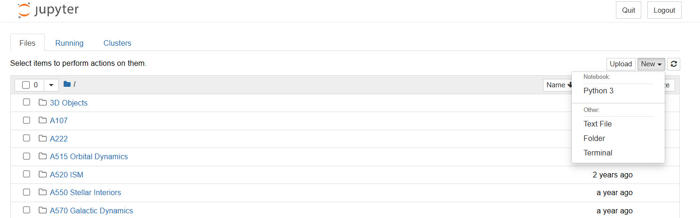
Start a Jupyter notebook
“New” -> “Python 3”
Write your code!

